Slide 1
Data-Driven Analysis for Movement Solutions
Unlocking Insights for Business Growth
B NITIN KUMAR

Slide 2
About the Project
Brief description of the mobility company and its goals.
Key objectives of the project (e.g., improve customer engagement, optimize sales, analyze performance).
Importance of data-driven insights in achieving these goals.

Slide 3
Key Business Highlights
Breakdown of major insights such as revenue trends, order distribution, and customer engagement.
Use infographics or charts for quick visualization.

Slide 4
Project Objectives
Analyze order value trends across regions and customers.
1
Measure the impact of customer meetings on sales performance.
2
Assess sales agent performance and product engagement.
3
Identify key regions and customers driving revenue growth.
4
Develop actionable recommendations based on insights.
5

Slide 5
Approach and Methodology
Data Collection:
Raw data was extracted from multiple Excel files that contained sales records, customer meetings, order details, and sales agent performance metrics.
Data was cleaned and structured for analysis to remove inconsistencies like duplicate records, missing values, or outliers.
Data Processing in SAP Analytics Cloud:
Data was uploaded into SAP Analytics Cloud where it was integrated into a central model.
Key measures (e.g., Order Value, Units Sold, and Order Count) and dimensions (e.g., Region, Sales Agent, Product) were modeled for analysis.
Calculated measures (e.g., discount impacts and performance ratios) were created to enrich the analysis.
Visualization in Dashboards:
Created interactive dashboards in SAC focusing on:
Sales Performance: Highlighting overall sales trends, order values, and customer engagement metrics.
Geographic Insights: Visualizing order distribution and performance across regions using heatmaps.
Sales Agent Analysis: Detailing individual sales agents' contributions to revenue and units sold.
Added visual tools like bar charts, tables, maps, and word clouds for intuitive data presentation.
Tools and Techniques:
Data Integration: Merging Excel files into SAP Analytics Cloud.
Data Modeling: Defining relationships between datasets for comprehensive analysis.
Visualization: Using dynamic widgets like geo-maps, KPI tiles, and ranking tables to present insights effectively.

Slide 6
Metrics Driving Analysis
Metric | Description
Order Value | Total revenue generated from each order.
Units Sold | Total number of products sold across regions and customers.
Customer Meetings | The number of customer interactions conducted by the sales team.
Order Count | Total number of orders placed, analyzed by region and customer type.
Sales Agent Performance | Evaluation of sales agents based on their contribution to revenue and units sold.
Product-Level Insights | Analysis of which products drive the highest sales and engagement.

Slide 7
High-Level Insights
Regional Insights:
Certain regions (e.g., the United States and China) contributed the highest sales volumes and order values.
Underperforming regions were identified where customer meetings and sales engagement were lower.
Impact of Discounts:
A direct correlation was observed between discounts offered and increased order values for certain customers.
However, some regions with higher discounts showed reduced profitability.
Sales Agent Performance:
Top-performing agents consistently generated higher order values and engaged with more customers.
Performance varied widely, with some agents excelling in specific regions while others underperformed.
Product Trends:
Certain products had consistently high sales across all regions, indicating strong demand.
Low-performing products were identified for potential repositioning or discontinuation.
Customer Engagement Trends:
Regions with higher customer meetings showed a stronger correlation with increased order values and unit sales.
Opportunities were identified to improve engagement in regions with low meeting frequencies.

Slide 8
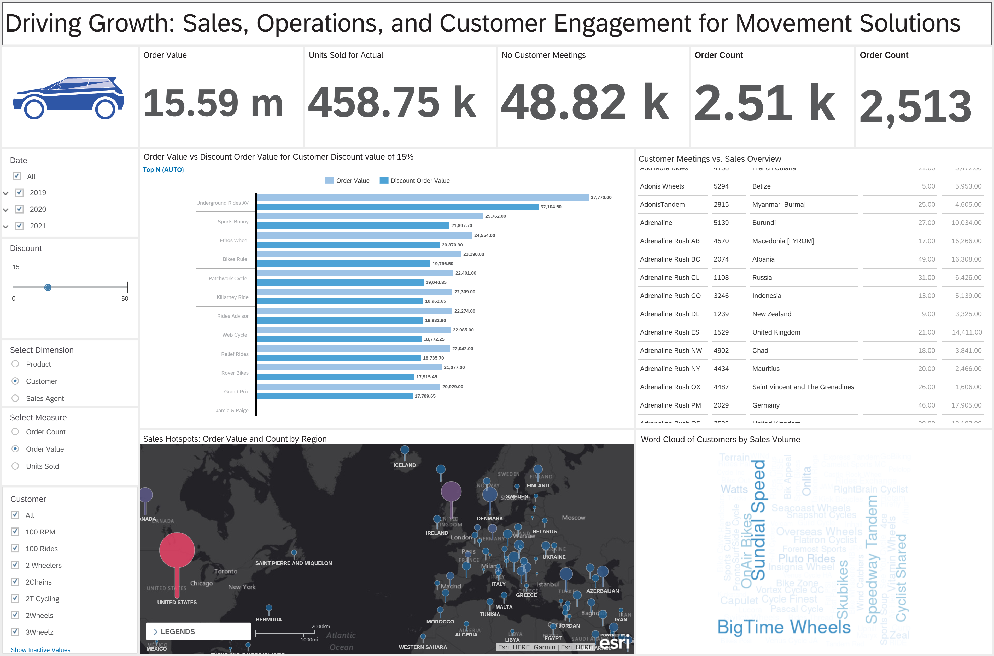

Slide 9
